Slide 1

Stage 2 Star Next To Texas Course Designer: Chu Xu
Star Next To Texas is a 21 round, 105 point, COMSTOCK Long course. There are 6 USPSA targets and 9 steel targets. The best 2 hits per cardboard target will score. Steel must fall to score.
The handgun start position is standing with feet touching the start stick, wrists below belt. Handgun is loaded and holstered. PCC start position is standing with feet touching the start stick, stock on belt, muzzle pointing downrange, safety on.
On the audible start signal, engage all targets from within the shooting area. P3 activates S1, which remains visible at rest.

Slide 2
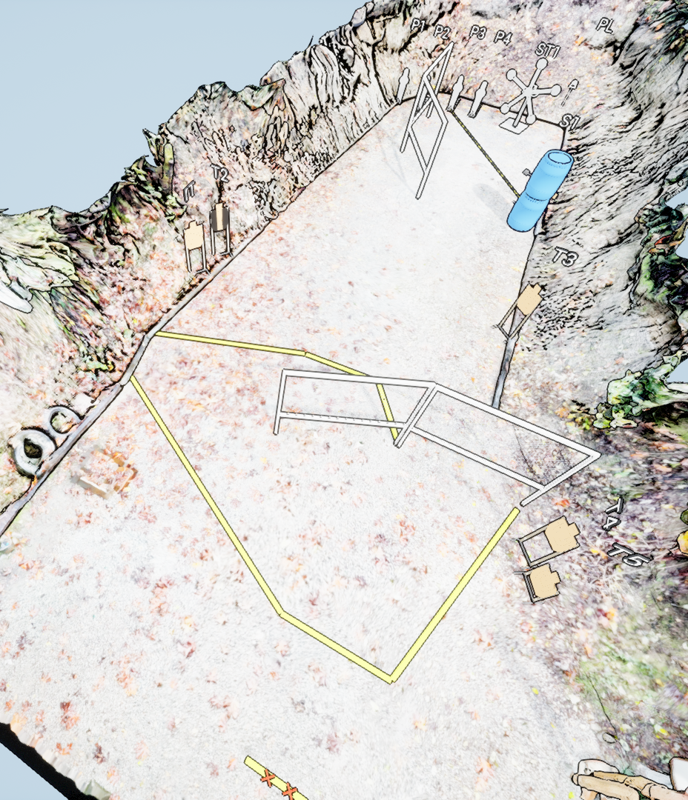
 | Stage 2 Star Next To Texas Course Designer: Chu Xu

